Slide 1
Analysis of Data-Centric Workflows
Victor Vianu
UC San Diego & INRIA-Saclay
Joint work with: S. Abiteboul, P. Bourhis, E. Damaggio,
A. Deutsch, R. Hull, A. Koutsos, F. Patrizi, L. Sui, D. Zhou

Slide 2
Workflows centered around data
Increasingly common:
E-commerce
Supply chain management
Case management in health-care
Scientific workflows
Business processes
  ….
Complex logic → need for analysis tools

Slide 3
Analysis tasks
Automatic verification of desirable properties
“no product can be shipped before being paid”
“if a product is paid, it is eventually delivered or the
customer is refunded”
Comparison and customization of workflows
“is my workflow equivalent to yours ?”
Runtime analysis for collaborative workflows
“what can I infer from my local view of the workflow?”
“what should I do next?”

Slide 4
Facilitated by emergence of high-level specification tools
Examples:
WebRatio (Milano)
Wave (UCSD)
Hilda (Cornell)
Active XML (INRIA)
Business artifacts (IBM)
Ideal targets for logic-based analysis
Notes:
declarative spec tools

Slide 5
New area at the intersection of
Databases and Computer-Aided Verification
promising theory and some implementation
potential for significant practical impact
wide open, rich source of research problems
Notes:
emerging area .. dealing with verification ...

Slide 6
Outline
Automatic Verification
PODS 2004, SIGMOD 2005, PODS 2006, JCSS 2007
PODS 2008, ICDT 2009, TODS 2009, ICDT 2011
BPM 2011, TODS 2012
A. Deutsch, E. Damaggio, R. Hull, Y. Li, F. Patrizi, L Sui, D. Zhou
Comparison and customization of workflows
ICDT 2011, TODS 2012, ICDT 2015
S. Abiteboul, P. Bourhis, A. Koutsos
Runtime analysis for collaborative workflows
PODS 2013
S. Abiteboul

Slide 7
What is a data-centric workflow?
Semantics
States (data)
Events (with data)
Transitions
state
event
state
event
state
event
state

Slide 8
Infinite-state transition system
....

Slide 9
Specifications of data-centric workflows
Two examples:
Interactive Web applications (à la WebRatio)
data: web pages, internal state
events: user input
Business Artifacts (IBM Watson)
data: relational database, evolving “artifact”
events: services with pre/post conditions

Slide 10
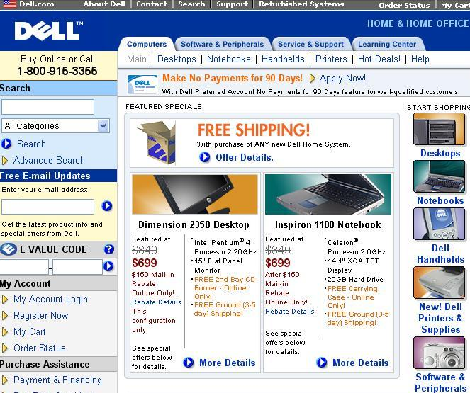
Input
Input
Input
Trigger state update and transition to new page
Input

Slide 11

Home Page(HP)
Message Page
(MP)
NAME:
PASSWD:
WebRatio:
high-level specification tool
Message
login
cancel
back
Customer Page(CP)
laptop
desktop
DB
Laptop Search (LSP)
Desktop Search (DSP)
RAM:
CPU:
SCREEN:
RAM:
CPU:
submit
submit
Matching products
Details
Confirmation
buy
print
Product Detail
(PDP)
Confirmation
(CoP)
Product Index (PIP)

Slide 12
Home Page(HP)
Message Page
(MP)
NAME:
PASSWD:
WebRatio:
high-level specification tool
Message
login
cancel
back
Customer Page(CP)
laptop
desktop
DB
Laptop Search (LSP)
Desktop Search (DSP)
RAM:
CPU:
SCREEN:
RAM:
CPU:
submit
submit
Matching products
Details
Confirmation
buy
print
Product Detail
(PDP)
Confirmation
(CoP)
Product Index (PIP)

Slide 13
Home Page(HP)
Message Page
(MP)
NAME:
PASSWD:
WebRatio:
high-level specification tool
Message
login
cancel
back
Customer Page(CP)
laptop
desktop
DB
Laptop Search (LSP)
Desktop Search (DSP)
RAM:
CPU:
SCREEN:
RAM:
CPU:
submit
submit
Matching products
Details
Confirmation
buy
print
Product Detail
(PDP)
Confirmation
(CoP)
Product Index (PIP)

Slide 14
Home Page(HP)
Message Page
(MP)
NAME:
PASSWD:
WebRatio:
high-level specification tool
Message
login
cancel
back
Customer Page(CP)
laptop
desktop
Matching-products (pid,price) ← ∃ ram ∃ cpu
search(ram,cpu) ∧ catalog(pid,ram,cpu,price)
Laptop Search (LSP)
Desktop Search (DSP)
RAM:
CPU:
SCREEN:
RAM:
CPU:
user input
submit
db table
submit
Matching products
Details
Confirmation
buy
print
Product Detail
(PDP)
Confirmation
(CoP)
Product Index (PIP)
Notes:
Now that we have seen how web services are specified, let us look
at verification.

Slide 15

Home Page(HP)
Message Page
(MP)
NAME:
PASSWD:
WebRatio:
high-level specification tool
Message
login
cancel
back
Customer Page(CP)
state update
laptop
desktop
Laptop Search (LSP)
Desktop Search (DSP)
RAM:
CPU:
SCREEN:
RAM:
CPU:
Web application code
submit
submit
Matching products
Details
Confirmation
buy
print
Product Detail
(PDP)
Confirmation
(CoP)
Product Index (PIP)

Slide 16
IBM’s Business Artifacts
Simplest version: Tuple Artifacts
evolving tuples of data values
product order, loan application, etc
fixed underlying relational database
services ( ∃FO pre/post conditions on artifact tuples and the database)

Slide 17




Example: e-commerce website
Not all shipping types might be allowed
A coupon might give a discount or provide free shipping
Coupons might be applicable with a minimum purchase
customer
e-seller
At any point before the shipping the customer can cancel the order and request a refund
Customer picks a product
Customer picks a compatible shipping type
Customer can apply a valid coupon
E-shop provides total price
Customer send payment
If the payment matches total price, the product is shipped
Some useful properties to verify:
No product can be shipped before it is paid
If the correct payment is received, the product is eventually shipped or the customer
is refunded
Notes:
Fix bubbles…
17

Slide 18
Example (cont’d)
Single artifact record:
Status | Prod_id | Ship_type | Coupon | Amount owed | Amount paid | Amount refunded
Foreign keys:
COUPONS[free_shiptype] ⊆ SHIPPING[type]
OFFERS[prod_id] ⊆ PRODUCTS[id]
Underlying database:
PRODUCTS(id, price, availability, weight)
COUPONS(code, type, value, min_value, free_shiptype)
SHIPPING(type, cost, max_weight)
OFFERS(prod_id, discounted_price, active)
Keys
Notes:
18

Slide 19
Services, by example
Every precondition is evaluated on the current snapshot
Services:
One is chosen non-deterministically
Current snapshot:
pre
Modify
product
post
Successor snapshot:
Status | Edit shiptype
Product id | 23
Ship type
Coupon
Status | Edit shiptype
Product id | 23
Ship type
Coupon
Status | Edit coupon
Product id | 23
Ship type | Fedex 2-day
Coupon
Edit coupon
23
Fedex 2-day
pre
Choose
shiptype
post
…
pre
Service n
post
Run (infinite sequence of successive artifacts):
DB
processing
23
Fedex 2-day
$50 coupon
…
Notes:
Light bubbles!!!!
19

Slide 20
Specifying properties: extension of LTL
Gp
Fp
Xp
pUq
G: always F: eventually X: next U: until

Slide 21
Propositions → ∃ FO formulas
p q
ϕ_{p}
ϕ_{q}
...

Slide 22
Propositions → ∃ FO formulas
need to connect data values across configurations
ϕ_{p}
ϕ_{q}
...
...
“every paid product is eventually delivered”

Slide 23
Propositions → ∃ FO formulas
need to connect data values across configurations
ϕ_{p}(x)
ϕ_{q} (x)
...
...
“every paid product is eventually delivered”

Slide 24
Propositions → ∃ FO formulas
need to connect data values across configurations
∃y (pay(x,y) ∧ price(x,y))
delivered (x)
...
...
“every paid product is eventually delivered”

Slide 25
Propositions → ∃ FO formulas
need to connect data values across configurations
∃y (pay(x,y) ∧ price(x,y))
delivered (x)
...
...
Global variables: similar to freeze quantifier [Demri]

Slide 26
“every paid product is eventually delivered”
∀x
G ( p → F q)
∃y (pay(x,y) ∧ price(x,y))
delivered (x)
LTL-FO

Slide 27
Verification problem
A
ϕ
VERIFIER
YES
NO, counterexample
Good news: Can automatically verify
significant classes of artifact systems !

Slide 28
Simplest case: tuple artifacts with no arithmetic or dependencies
Given an artifact system Α and LTL-FO property ϕ.
Theorem: It is decidable whether every run of Α satisfies ϕ. Complexity: PSPACE-complete (for fixed database schema).
Recall: finite-state case is already PSPACE-complete

Slide 29
Main idea of proof
Wish to verify ϕ
Search for counter-example run satisfying ¬ ϕ
Well-known how to do in the finite-state case,
using Büchi automata
Notes:
Mention here that we have an implementation. PSPACE is a theoretical upper bound, no indication on practicality.

Slide 30
Classical finite-state case
Run :
States of B(¬φ) :
Non-deterministic PSPACE algorithm
S S
…
s₀ s₁ s₂ … f …. f
accept
S,f
“lasso path”

Slide 31
Challenge: artifacts are not finite-state
infinite data domain → infinite state space
Goal: reduce back to finite state!

Slide 32
Main idea: symbolic approach
Search for counterexample run satisfying ¬ ϕ
¬ ϕ = ∃ X ¬ ψ
global variables are skolemized away
Symbolic run: isomorphism type of consecutive configurations
DB|(consecutive artifact values + constants)
Notes:
Mention here that we have an implementation. PSPACE is a theoretical upper bound, no indication on practicality.

Slide 33
PSPACE algorithm
Non-deterministic search for counterexample symbolic run
....
....
....
S
S
B(¬φ)
s₀ s₁ s₂ … f …. f
accept
S,f
“lasso path”

Slide 34
Implementation: WAVE prototype
Everything from scratch except LTL → Büchi
Extremely good performance
Key: optimization heuristics
[SIGMOD 2005, 2006]

Slide 35
Limitations:
no dependencies, no arithmetic
flat structure, no concurrency
Verification becomes undecidable even with:
A single key dependency
Post Correspondence Problem
Very simple arithmetic (increment/decrement)
State reachability for counter machines
Extending artifact tuple with a single unary set
All are useful in artifact specifications ….

Slide 36
How to allow practical uses of dependencies, arithmetic and sets while avoiding undecidability?
Example: undecidability with arithmetic
simulating counters: unbounded propagation of values
counter
counter
counter
counter
Many practical workflows make
more limited use of arithmetic !

Slide 37
Our proposal: Hierarchical Artifact Systems
[Deutsch, Li, V.]
Specification framework inspired by
IBM’s Guard-Stage-Milestone artifact design tool
Intuition: allow arithmetic, dependencies, sets
and concurrency but limit them to realistic use

Slide 38
Hierarchical Artifact System
Prod_id | Ship_type | Coupon | Amount owed | Amount paid | Amount refunded
Purchase
product
Choose
coupon
Choose
shiptype
Process
payment
Process
refund
Process
shipment
Purchase
product
Prod_id, Ship_type, Amount_owed
Prod_id,
Ship_type,
Amount_owed,
Amount_paid
Choose
coupon
Choose
shiptype
Process
payment
Prod_id, Coupon
Prod_id Ship_type
Process
shipment
Process
refund
Prod_id,
Ship_type
Amount_owed,
Amount_refunded

Slide 39
Example
A
S
B
X
C
X
PARENT TASK
J
J
A | B | C
A | B | C |  |  |  |  |  | D | E
A | B | C |  |  |  |  |  | X | Y
A | B | C | R | X | J |  |  | X | Y
A | B | C | R | X | J | P | L | X | Y
R
R
Y
P
CHILD TASK 2
L
B
CHILD TASK 1
A | R | J | Y | Q | Y
A | R | J | Y | P | L
C | X
A | R | J | Y
C | X |  |  | D | J
C | X | R | S | D | J
X
L
Y

Slide 40
Hierarchical Artifact System
Purchase
product
Choose
coupon
Choose
shiptype
Process
payment
Process
shipment
Process
refund
Run: any legal interleaving of transitions
of concurrently running tasks

Slide 41
Properties: Hierarchical LTL-FO
Variant insensitive to interleavings of concurrent tasks
Idea: recursively constrain runs of services and their children along the hierarchy
Logic is “complete”: captures exactly the fragment of LTL-FO insensitive to legal interleavings
Proof uses results of Diekert & Gastin on temporal logics
complete for Mazurkiewicz traces

Slide 42
Main result: decidability of verification
No sets, no arithmetic: PSPACE
Sets, no arithmetic: EXPSPACE
Sets and arithmetic: 3-EXPSPACE
Main technical tools:
Vector Addition Systems (to deal with sets)
results by M. Blockelet, S. Schmitz & P. Habermehl
Cylindrical algebraic decomposition (for arithmetic)

Slide 43
Analysis tasks
Automatic verification of desirable properties
“no product can be shipped before being paid”
“if a product is paid, it is eventually delivered or the
customer is refunded”
Comparison and customization of workflows
Abiteboul, Bourhis, Koutsos
“is my workflow equivalent to yours ?”
Runtime analysis for collaborative workflows
“what can I infer from my local view of the workflow?”
“what should I do next?”

Slide 44
Why compare different workflows?
Customization
Integration
Optimization
Comparing expressiveness of workflow languages

Slide 45
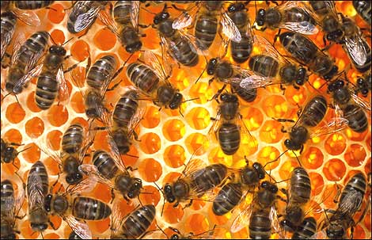
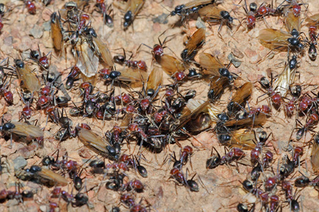
How to compare different workflows?
Building a beehive
Building an ant nest

Slide 46
Use Views!
bee
insect
ant
hive
dwelling
nest
Building a beehive
Building an ant nest

Slide 47
Use Views!
Map to a common abstraction
Define a notion of simulation
Building a beehive
Building an ant nest

Slide 48
Use Views!
Allows to compare
very different workflows
Building a beehive
Building an ant nest

Slide 49
Example: Active XML vs Artifacts
Active XML workflows can simulate Artifacts
with respect to appropriate abstractions
Artifacts cannot simulate Active XML

Slide 50
Customizing workflows
Example: providing process-centric views
When is the service view ω-regular ?
When is more powerful specification needed?
Similar questions for branching-time semantics
[Koutsos, V.]
Service view: valid sequences of service calls

Slide 51
Analysis tasks
Automatic verification of desirable properties
“no product can be shipped before being paid”
“if a product is paid, it is eventually delivered or the
customer is refunded”
Comparison and customization of workflows
“is my workflow equivalent to yours ?”
Runtime analysis for collaborative workflows
Abiteboul + V.
“what can I infer from my local view of the workflow?”
“what should I do next?”

Slide 52




Collaborative workflows
Business processes, health care,
scientific workflows, government …

Slide 53
actions & data
actions & data
actions & data
actions & data
tasks & honey
tasks & honey
tasks & honey
tasks & honey
Author
PC chair
PC member
Referee
Some possible actions
Author: submit, respond, final, copyright
PC chair: assign, discuss, decide, notify, remind
PC member: enter review, invite referee, discuss

Slide 54
The collaborative workflow model [Abiteboul+V.]
actions & data
actions & data
actions & data
actions & data
tasks & honey
tasks & honey
tasks & honey
tasks & honey
Author
PC chair
PC member
Referee
Simple peer views
virtual database

Slide 55
Submitted Id title author abstract
Submitted Id title abstract
σ
Author
Author = self
PC member
Submitted Id title author abstract
PC chair

Slide 56
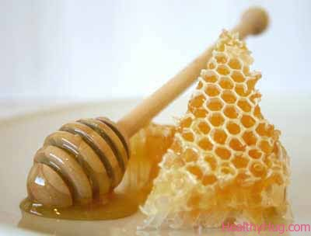
action
actions & data
actions & data
actions & data
actions & data
tasks & honey
tasks & honey
tasks & honey
tasks & honey
Author
PC chair
PC member
Referee
virtual database

Slide 57
action
actions & data
actions & data
actions & data
actions & data
tasks & honey
tasks & honey
tasks & honey
tasks & honey
Author
PC chair
PC member
Referee
virtual database

Slide 58
Focus runtime peer reasoning about global run based on local observations
Monitoring events
Diagnosing anomalous behavior
Competitive advantage
Has my paper been accepted?
A paper was assigned to a PC member with a COI:
could the assignment have been made by the PC chair,
or was it necessarily made by a track chair?
Is my own submission as a PC member still under discussion?

Slide 59

Runtime peer reasoning about global run based on local observations
Trace ρ
Infinitely many compatible global runs

Slide 60
Semantics of property φ of global runs relative to a trace ρ
Cert(φ) : φ holds in every global run compatible with ρ
Poss(φ) : φ holds in some global run compatible with ρ

Slide 61
Goal
Given a workflow specification W,
a trace ρ and a PLTL-FO property φ of global runs
evaluate Cert(φ) and Poss(φ)
Theorem: Cert(φ) and Poss(φ) can be evaluated
in PSPACE with respect to φ and ρ.

Slide 62
Proof idea
Trace ρ
Infinitely many compatible global runs
Symbolic transition system

Slide 63
Proof idea
Trace ρ
symbolic instances
variables + constraints

Slide 64
Proof idea
Trace ρ
Transitions
among symbolic instances
each computed in PSPACE

Slide 65
Proof idea
Trace ρ
Finite-state transition system on which
Poss(φ) can be evaluated
by a nondeterministic PSPACE search
Cert(φ) = ¬ Poss(¬ φ)

Slide 66
Other results
Incremental evaluation
Pre-emptive monitoring
Can be done for classes of properties sharing a temporal type:
underlying propositional PLTL formula
Example: G⁻¹ (p → F ⁻¹ q)
FO
FO

Slide 67
Other results
Incremental evaluation
Pre-emptive monitoring
Using knowledge about global run
in workflow specifications
PC member
As long as I don’t know that my paper is accepted,
I will reject every other paper
Reject(ID) :- paper(ID, author), author ≠ self,
¬ cert (“my paper is accepted”)
epistemic atom

Slide 68
Summary
Analysis tasks for data-centric workflows
Automatic verification
Comparing and customizing workflows
Runtime analysis for collaborative workflows
Mostly theoretical results so far
Hope: practical analysis tools

Slide 69
Summary
Analysis tasks for data-centric workflows
Automatic verification
Comparing and customizing workflows
Runtime analysis for collaborative workflows
Still a new area, much more to be done!

Slide 70
Thank you !
Merci !

