Slide 1

Determinism,Electricity, and Intuitionism
Gérard Berry
http://www-sop.inria.fr/members/Gerard.Berry/
Collège de France
Algorithms, Machines, and Languages Chair
Martin-Honoris Abadi-Causa, June 26th, 2015

Slide 2
Recognizing Automata
b
b
b
e₀
e₂
s₀
s₂
a
a
a
a
b
b
b
e₁
e₃
s₁
s₃
Deterministic
Non-deterministic
(w.r.t. s₀ and b)
2

Slide 3
Derivatives of Regular Languages
L →
ba, abba, bba, abbabba, bbbbababbbbba,...
a⁻¹(L) →
ba, abba, bba, abbabba, bbbbababbbbba,...
b⁻¹(L) →
ba, abba, bba, abbabba, bbbbababbbbba,...
u⁻¹(L) = { v | u v ∈ L } ua⁻¹(L) = a⁻¹(u⁻¹(L))
what remains to be written after writing u
3

Slide 4
Derivatives of Regular Expressions
a⁻¹(e) = regular expression generating a⁻¹(L(e))
a⁻¹(0) = 0
a⁻¹(1) = 0
a⁻¹(b) = 0 if b ≠ a
a⁻¹(a) = 1
a⁻¹(e + e’) = a⁻¹(e) + a⁻¹(e’)
a⁻¹(e · e’) = a⁻¹(e) · e’ + ε(e) · a⁻¹(e’)
a⁻¹(e* ) = a⁻¹(e) · e*
4

Slide 5
Convergent Iterative Process
e = e₀ = (ab + b)* ba
a⁻¹(e₀) = b (ab + b)* ba = e₁
b⁻¹(e₀) = (ab + b)* ba + a = e₂
a⁻¹(e₁) = 0
b⁻¹(e₁) = (ab + b)* ba = e₀
a⁻¹(e₂) = b (ab + b)* ba + 1= e₃
b⁻¹(e₂) = (ab + b)* ba + a = e₂
a⁻¹(e₃) = 0
b⁻¹(e₃) = (ab + b)* ba = e₀

Slide 6
Constructing the Deterministic Automaton
a⁻¹(e₀) = e₁
b⁻¹(e₀) = e₂
b
b
e₀
e₂
a⁻¹(e₁) = 0
b⁻¹(e₁) = e₀
a
a
b
b
a⁻¹(e₂) = e₃
b⁻¹(e₂) = e₂
e₁
e₃
a⁻¹(e₃) = 0
b⁻¹(e₃) = e₀
ε(e₃) = 1
deterministic automaton
(Brzozoswki)

Slide 7
Linear Expression
an expression is linear if it contains each letter at most once
linearize expressions by uniquely indexing letters
b₂
s₀ = (a₀b₁ + b₂)* b₃a₄
a₀⁻¹(s₀) = b₁(a₀b₁ + b₂)* b₃a₄ = s₁
b₂⁻¹(s₀) = (a₀b₁ + b₂)* b₃a₄ = s₀
b₃⁻¹(s₀) = a₄ = s₂
b₁⁻¹(s₁) = s₀
a₄⁻¹(s₀) = ε = s₃
b₃
s₀
s₂
a₀
a₄
b₁
s₁
s₃

Slide 8
Non-Deterministic Automaton
b₂
b
erase
indices
b₃
b
s₀
s₂
s₀
s₂
a₀
a₄
a
a
b₁
b
s₁
s₃
s₁
s₃
Non-deterministic automaton
recognizing L(e₀)

Slide 9
Implementation by Boolean Circuits
a
a
1
ok

Slide 10
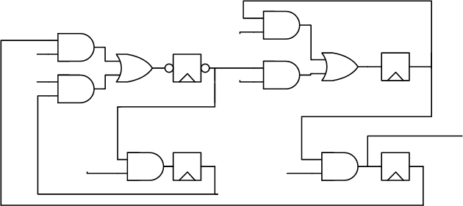
The Deterministic Case : 1-hot encoding
b
b
e₀
e₂
1-hot encoding
(only one r_{i} to 1)
size explosion!
fanout explosion !
a
(ab+b)*ba
a
b
b
e₁
e₃
r₀
b
r₂
b
b
b
r₁
ok
a
a
r₃
10

Slide 11

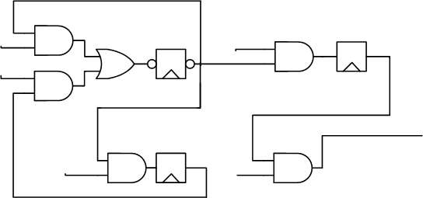
The Non-Deterministic Case
b
b
s₀
s₂
a
a
no size explosion
much better!
(ab+b)*ba
b
s₁
s₃
b
b
b
ok
a
a
11

Slide 12
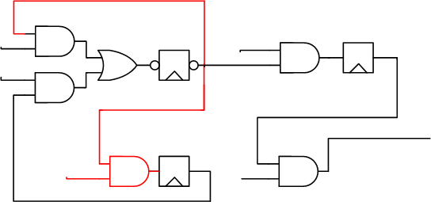
On-The-Fly Subset Construction
b
b
s₀
s₂
a
a
(ab+b)*ba
b
s₁
s₃
a
b
b
b
ok
a
a
12

Slide 13
On-The-Fly Subset Construction
b
b
s₀
s₂
a
a
tick!
(ab+b)*ba
b
s₁
s₃
a
b
b
b
ok
a
a
13

Slide 14
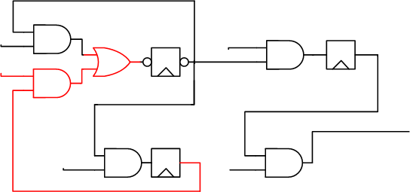
On-The-Fly Subset Construction
b
b
s₀
s₂
a
a
(ab+b)*ba
b
s₁
s₃
ab
b
b
b
ok
a
a
14

Slide 15
On-The-Fly Subset Construction
b
b
s₀
s₂
a
a
tick!
(ab+b)*ba
b
s₁
s₃
ab
b
b
b
ok
a
a
15

Slide 16
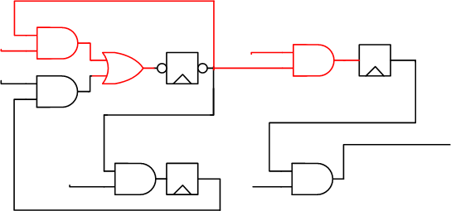
On-The-Fly Subset Construction
b
b
s₀
s₂
a
a
(ab+b)*ba
b
s₁
s₃
abb
b
b
b
ok
a
a
16

Slide 17
On-The-Fly Subset Construction
b
b
s₀
s₂
a
a
tick!
(ab+b)*ba
b
s₁
s₃
abb
b
b
b
ok
a
a
17

Slide 18
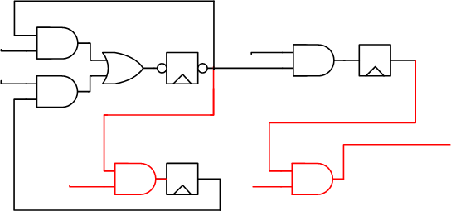
On-The-Fly Subset Construction
b
b
s₀
s₂
a
a
(ab+b)*ba
b
s₁
s₃
abba
b
b
b
ok
a
a
18

Slide 19
On-The-Fly Subset Construction
b
b
s₀
s₂
a
a
tick!
(ab+b)*ba
b
s₁
s₃
abba
b
b
b
ok
a
a
19

Slide 20
Fundamental Practical Result
Any regular expression of size n is recognized
by a circuit with n+1 registers and at most n² gates
Scales up in size, is always superfast
Almost always better than determinization
The circuit can be cleverly optimized
and formally verified (using BDDs or SAT)
20

Slide 21

Alternative: Dense Encoding ?
When coding the DFA in HW, why one register per state? Number states in binary → log(n) regs !
Not Quite ! State transition logic can be
exponential in the number of registers.
Furthermore, n! numberings to try,
and no heuristics for that!
Expensive commercial systems cannot
handle really useful DFAs with 12 states

Slide 22
Saving One More Exponential : ABRO
Emit O as soon as A and B have arrived
Reset behavior each time R is received
Memory write
R : Request
A : Address
B : Data
O : Write
R /
R /
A /
B /
R /
A B / O
R /
B / O
A / O

Slide 23
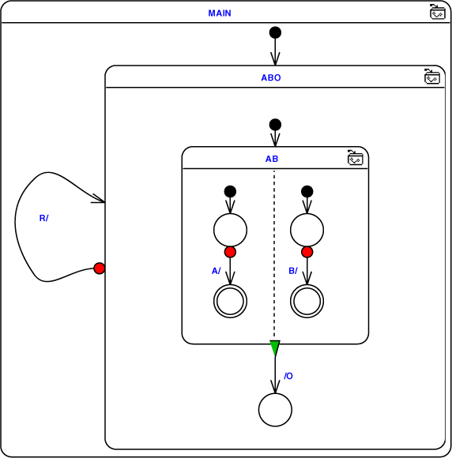
SyncCharts (C. André)
loop
abort
{ await A || await B };
emit O ;
halt
when R
end loop
R /
A /
B /
/ O
Hierarchical synchronous
concurrent automata
(Synchronous Statecharts)

Slide 24
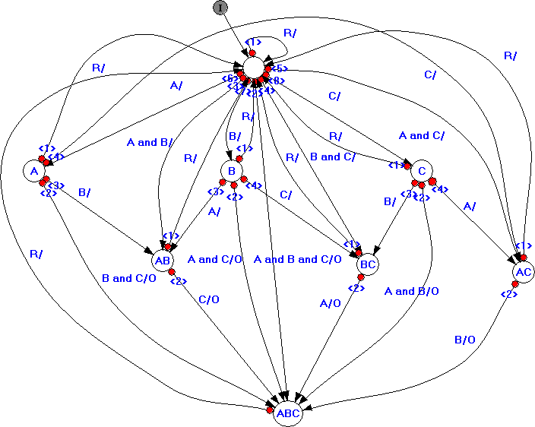
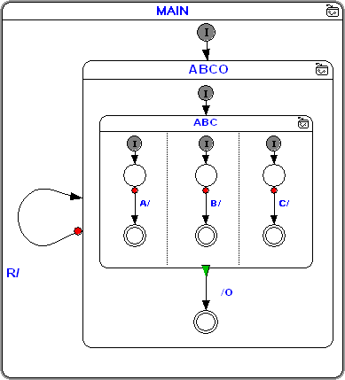
ABCRO : from exponential to linear
flat automaton
Hierarchical automaton
linear

Slide 25
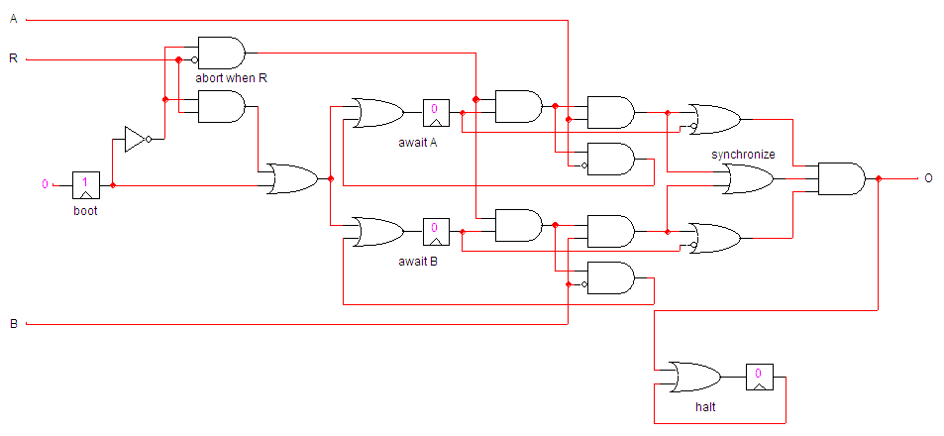
The Hierarchical ABRO Circuit
loop
abort
{ await A || await B };
emit O ;
halt
when R
end loop

Slide 26
Conclusion 1
Should we still beleive in DFAs?
NFAs are deterministic if use in the proper way !
… and they save an exponential
Synchronous languages a la Esterel / SyncCharts
save at least another exponential (see D. Harel) !
They can be efficiently implemented in HW and SW
always better than human designs !
Analysis and verification can be performed by symbolic techniques (BDDs, SAT, SMT)
…which might be exponential but do work quite well
in practice

Slide 27
Resource Sharing ⇒ Combinational Cycles
O := if C then F(G(I)) else G(F(I))
C
1
0
F
C
I
1
0
O
1
0
G
C
Sharad Malik, Analysis of Cyclic Combinational Circuits
IEEE Transactions on Computer-Aided Design of Integrated
Circuits and Systems, vol. 13, no. 7, July 1994

Slide 28
Resource Sharing ⇒ Combinational Cycles
O := if C then F(G(I)) else G(F(I))
C
cycle
1
0
F
C
I
1
0
O
1
0
G
C

Slide 29
Resource Sharing ⇒ Combinational Cycles
C = 1 ⇒ O = if C then F(G(I)) else G(F(I))
1
1
0
F
1
I
1
0
O
1
0
G
1

Slide 30
Resource Sharing ⇒ Combinational Cycles
C = 0 ⇒ O = if C then F(G(I)) else G(F(I))
0
1
0
F
0
I
1
0
O
1
0
G
0
The cycle is logically sound
and electrically sound !

Slide 31

ILD = Instruction Length Decoder
1
4
6
2
3
5
16-bytes circular buffer, bytes coming in randomly
Instruction length depending on the first byte and a variable number of other bytes in the instruction text
Instruction length potentially arbitrary
Naturally cyclic design, hard to make acyclic

Slide 32
The Three Kinds of Cyclic Circuits
Good : electrical stabilization, logical consistency
  previous examples
Bad : no electrical stabilization, no unique logical solution
  X := X
  X := ¬X
Weird : unique logical solution, but electrical stabilization depending on wire and gate delays
  ToBe := ToBe ∨ ¬ToBe
ToBe
no electrical stabilization when starting
from ToBe =0 with D=2 and E=5
D
E

Slide 33
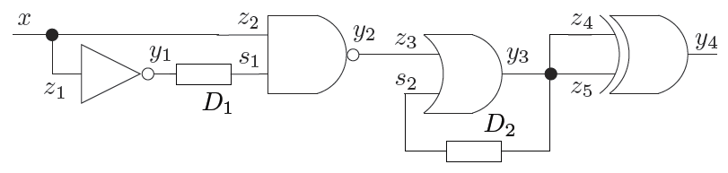
Circuits With Delays
d1
d2
Logical gates : zero-delay, grouping possible
  polynomial notation : y₁ = x, s₂ = s₁x+s₂ = s₁+x+s₂
Explicit delay nodes
At least one delay per cycle

Slide 34
UN-Delay and Stability
< d
d
h
d
< d
h’
t
t+d
UN-delay : d∈ℝ⁺
h[t,u)=b and t+d < u ⇒ h’[t+d,u)=b
A history h is stable at b after a delay d if h[d,∞) = b
Otherwise, h is called unstable or oscillating

Slide 35
Intuitionistic Negation
Goal : to represent the not gate
  x stable to 1 : h[t,u) ⊨ x
  logical opposite : h[t,u) ⊨ x
  but the logical opposite is satisfied by any unstable signal
  we want x stable to 0, i.e. ¬x ≡ x, which is different!
1
0
0
t
u
neither h[t,u) ⊨ x nor h[t,u) ⊨ x
h[t,u) ⊨ ¬φ iff ∀[t’,u’)⊂[t,u). h[t’,u’) ⊨ φ
φ is never satisfied by h on [t,u)
different from φ is not satisfied by h !

Slide 36
Summary of UN-Logic Definition
h[t,u) ⊨ R if ∀τ∈[t,u). h(τ)∈R
h[t,u) ⊨ φ∧ψ if h[t,u) ⊨ φ and h[t,u) ⊨ ψ
h[t,u) ⊨ φ∨ψ if h[t,u) ⊨ φ or h[t,u) ⊨ ψ
h[t,u) ⊨ ¬φ if ∀[t’,u’)⊂[t,u). h[t’,u’) ⊨ φ
h[t,u) ⊨ φ⊃ψ if ∀[t’,u’)⊂[t,u). h[t’,u’) ⊨ φ ⇒ h[t’,u’) ⊨ ψ
h[t,u) ⊨ φ≡ψ if ∀[t’,u’)⊂[t,u). h[t’,u’) ⊨ φ ⇔ h[t’,u’) ⊨ ψ
h[t,u) ⊨ ◊_{d}φ if t+d < u if h[t+d,u) ⊨ φ
Notation : φ ⊨ ψ iff ∀h,t,u. h[t,u) ⊨ φ ⇒ h[t,u) ⊨ ψ

Slide 37
Deductive Calculus Formulae : ⊢ vs. ⊨
Timed region : θ = ◊_{d}R
Timed region : Θ = ∨_{k∈K} θ_{k} for K finite or infinite
Syntactic sequents
= Horn clauses ∧ ⊢ ∨
Φ(C,I) ⊢ Θ
(∧ _{s∈S} s :=_{d} e)
∧(∧ _{x∈I1} ◊₀x)
∧(∧ _{y∈I0} ◊₀y )
∨_{k∈K} θ_{k}
?
model :
Φ(C,I) ⊨ Θ

Slide 38
Computation = Deduction (Curry-Howard)
1. Φ(C,I) ⊢ θ = ◊_{d}R
iff there exists a sequence ◊_{d0}R₀, ◊_{d1}R₁,..., ◊_{dn}R_{n}= ◊_{d}R
such that, for all i, ◊_{di} is in Φ (i.e., an input value)
or derivable from the ◊_{dj}, j<i by a deduction rule
2. Φ(C,I) ⊢ Θ = ∨_{k∈K} θ_{k}
iff their exists k∈K such that Φ(C,I) ⊢ θ_{k}

Slide 39
Deduction Rules
◊true
for Φ(C,I) fixed,
Φ(C,I) ⊢ ... implicit everywhere
◊_{d}1
◊_{d}R d ≤ e R⊆S
◊bool
weakening
◊_{e}S
◊_{d}R R ⊃◊_{e}S
transition chaining
y :=_{e} x ⇔ (x ⊃◊_{e}y)∨(x ⊃ ◊_{e}y)
◊chain
◊_{d+e}S
◊_{d}S
◊_{e}T
◊join
gate inputs gathering
◊_{max(d,e)}S∩T
+ classical Boolean rules for regions
(OK since applied only to stable signals)
+ arithmetic operations on delays

Slide 40
d1
d2
Φ(C) = (s₁ :=_{d1} x) ∧ (s₂ :=_{d2} x+s₁+s₂)
◊₀x
◊₀x
◊bool
◊₀(x+s₁+s₂)
◊chain
◊chain
case x=0
i.e. ◊₀x
◊_{d1}s₁
◊_{d2}s₂
◊join
◊_{max(d1,d2)} s₁s₂
x=0 ⇒ region s₁s₂ reached in time max(d1,d2)

Slide 41
d1
d2
Φ(C) = (s₁ :=_{d1} x) ∧ (s₂ :=_{d2} x+s₁+s₂)
◊₀x
◊chain
◊_{d1}s₁
◊₀x
◊bool
◊_{d1}(x+s₁+s₂)
case x=1
i.e. ◊₀x
◊chain
◊chain
◊_{d1}s₁
◊_{d1+d2}s₂
◊join
◊_{max(d1, d1+d2)} s₁s₂
x=1 ⇒ region s₁s₂ reached in time d1+d2

Slide 42
The Key Theorems
Theorem 2 : equivalence of ⊨ and ⊢ for circuits
∀ C,I,Θ. Φ(C,I) ⊨ Θ ⇔ Φ(C,I) ⊢ Θ
Theorem 3 : Intuitionism of ⊨
∀ C,I,Θ. Φ(C,I) ⊨ Θ ⇒ ∃θ∈Θ. Φ(C,I) ⊨ θ
A disjunction (even infinite) can only by validated by one
of its members (immediate from Theorem 2 and definition
of Φ(C,I) ⊢ Θ)

Slide 43
The Central Result
Corollary : stabilization is deterministic
Let s a delay assignment for C and I an input vector. Then the histories h of s in (C,I) have only two possible behaviors:
  all the h stabilize to the same value
  there is at least one oscillating valid history h
⇒ A circuit is constructive iff its outputs cannot oscillate
Proof : let Θ = ◊₁s ∨ ◊₁s ∨ ◊₂s ∨ ◊₂s ∨ ◊₃s ∨ ◊₃s ∨...
Preuve ::then Θ (infinite) expresses that s stabilizes eventually
case 1 : Φ(C,I) ⊨ Θ. Then Φ(C,I) ⊨ θ_{k} for some k by thm.3
(intuitionism), for instance θ_{k} = ◊_{m}s.
Hence ∀h. h ⊨ Φ(C,I) ⇒ h ⊢ ◊_{m}s, any h stabilizes to 1
case 2 : Φ(C,I) ⊨ Θ. Then ∀h. h ⊨ Φ(C,I) ⇒ h ⊨ Θ is impossible.
Hence ∃h. h ⊨ Φ(C,I) ∧ h ⊨ Θ, and this h oscillates for s

Slide 44
Constructive Boolean Circuit Logic
Circuit C, input vector : I = inputs → {0,1}
formulae : I ⊢ e = b, written e = b when I constant
I input
e = 0
e = 1
I = I(I)
¬ e = 1
¬ e = 0
e = 0
e’ = 0
e = 1
e’ = 1
e ∧ e’ = 0
e ∧ e’ = 0
e ∧ e’ = 1
e = 1
e’ = 1
e = 0
e’ = 0
e ∨ e’ = 1
e ∨ e’ = 1
e ∨ e’ = 0
x := e ∈ C e = b
x = b

Slide 45
Proof Transformation Example
Φ(C) = (s₁ :=_{d1} x) ∧ (s₂ :=_{d2} x+s₁+s₂)
cas x=0
i.e. ◊₀x
◊₀x
◊₀x
◊bool
◊₀(x+s₁+s₂)
◊chain
◊chain
◊_{d1}s₁
◊_{d2}s₂
◊join
◊_{max(d1,d2)} s₁s₂
UN-logic
Constructive Boolean Logic
I(x)=0 ⊢ x=0
s₁:=¬x ∈ C
x=0
s₂ := ¬x∨s₁∨s
¬x∨¬s₁∨s₂ =1
s₁=1
s₂ =1
s₁=1 ∧ s₂=1

Slide 46
There We Are !
For given delays, UN-provability vs. ⊢ is a necessary and sufficient condition for UN-stabilization vs. ⊨
But any proof with delays can be transformed into a proof without delays, and conversely
Which means: Provability in Constructive Boolean Logic exactly
Which means: reflects electrical constructivity for all delays
Bonus: given the delays, proof-construction based simulation
computes the maximal reaction time w.r.t. each input

Slide 47


Conclusion
Etude complète de la stabilisation des circuits cycliques dans le modèle de délais UN, en reliant modèle ⊨ et déduction syntaxique ⊢, et en ignorant transitoires, oscillations, métastabilité etc. (qu’on peut aussi étudier)
stabilisation électrique ⇔ prouvabilité constructive booléenne
(avec délais) des sorties (sans délais)
A suivre au prochain cours :
  constructivité pour toutes entrées
  constructivité des circuits séquentiels (avec registres)
  algorithmes efficaces de calcul de la constructivité

Slide 48
References
Constructive Boolean Circuits and the Exactness of Timed Ternary Simulation
M. Mendler, T. Shiple et G. Berry.
Formal Methods in System Design, Vol.40, No.3, pp. 283-329, Springer (2012).
Constructive Analysis of Cyclic Circuits
T. Shiple, G. Berry et H. Touati.
Proc. Int. Design and Testing Conference IDTC'96, Paris, France (1996).
Asynchronous Circuits
J. Brzozowski et C-J. Seger.
Springer-Verlag (1995).

